Slide 1

Overwatch Database
Erika, Kevin, Timo, Roman

Slide 2
Outline
Idea
Entity
Relational Model
Database Schema
Queries
Erika, Kevin, Timo, Roman

Slide 3
Idea
Erika, Kevin, Timo, Roman

Slide 4
Idea
A database realization for our favorite game: Overwatch
Key takeaways:
Multiple Games
Dynamic Teams, newly created for each game
Heroes + abilities
Map & map-types
Persistent data (save every aspect of past games)

Slide 5
Entity Relational Model
Erika, Kevin, Timo, Roman

Slide 6
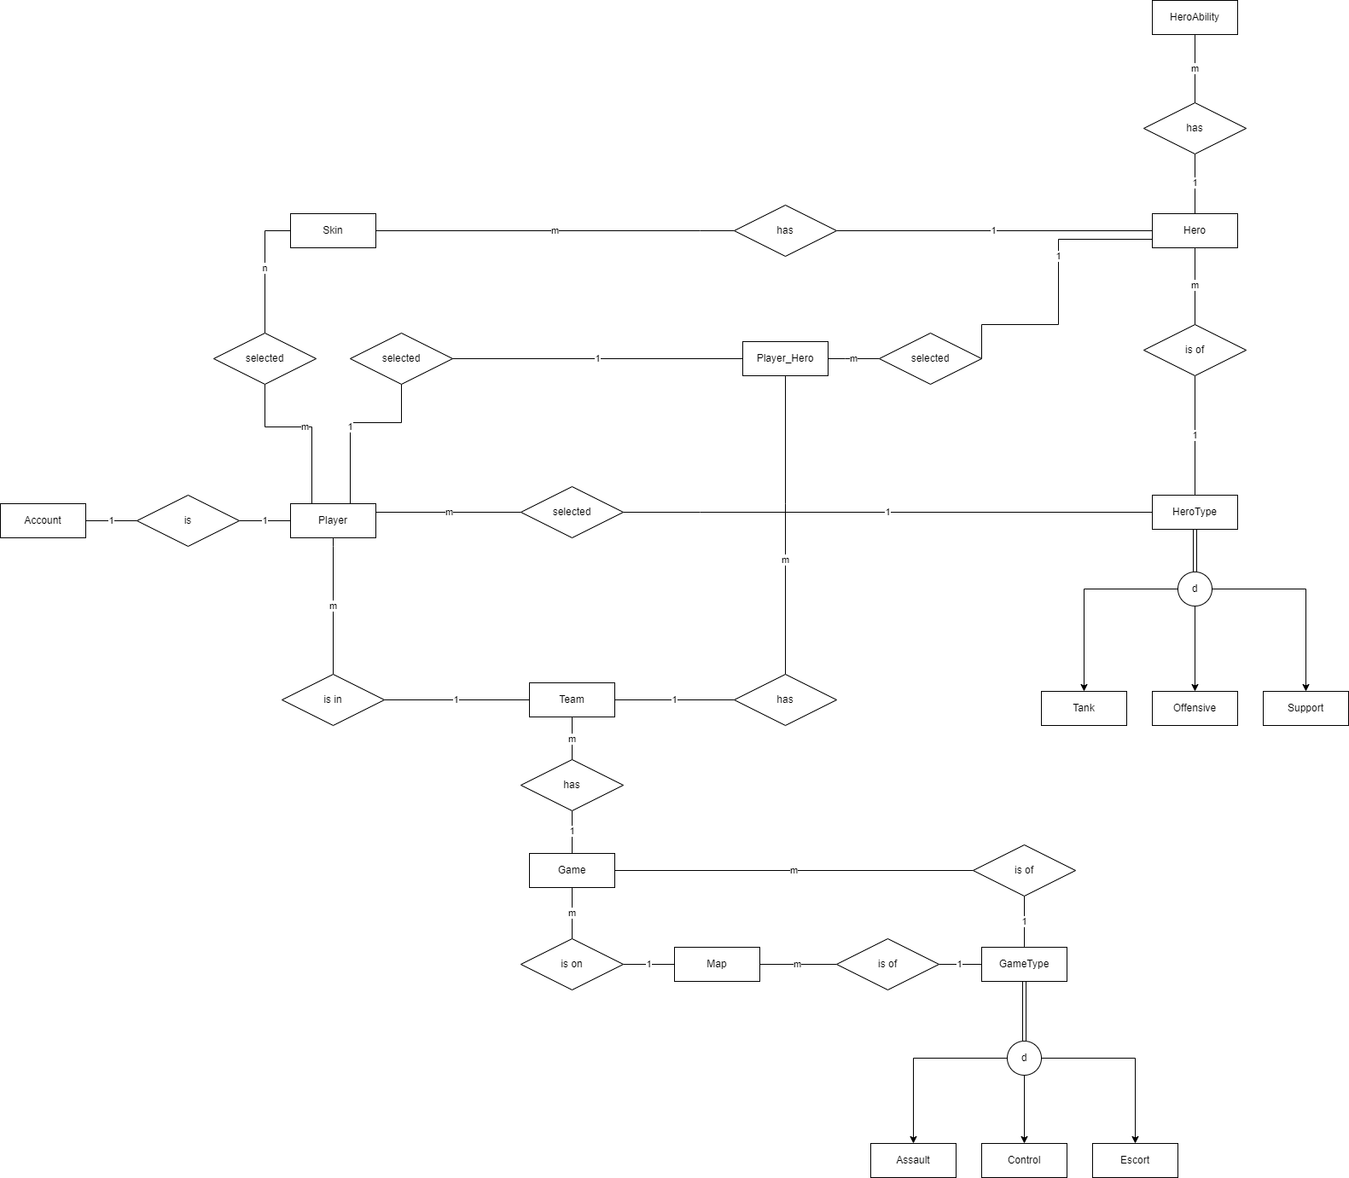
ERM

Slide 7
ERM

Slide 8
ERM

Slide 9
Database Schema
Erika, Kevin, Timo, Roman

Slide 10
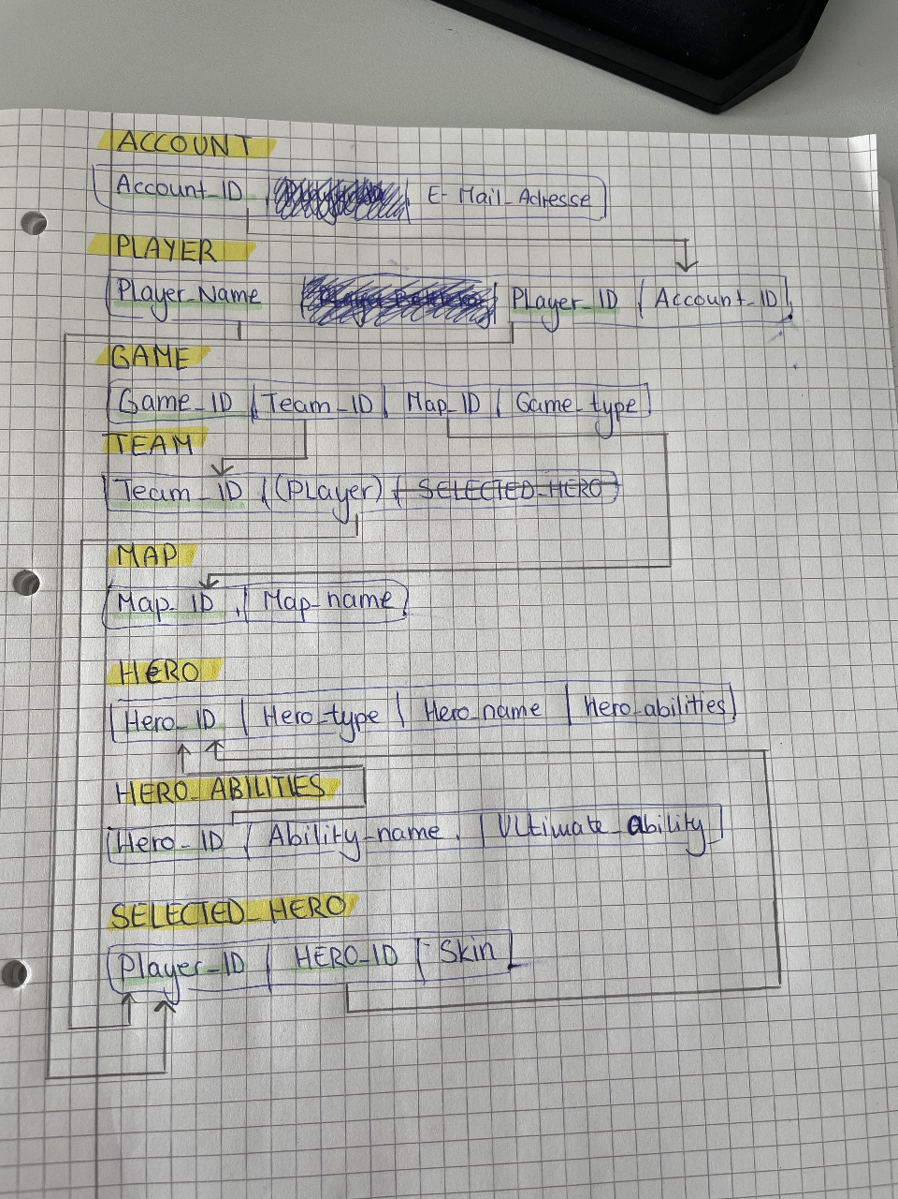
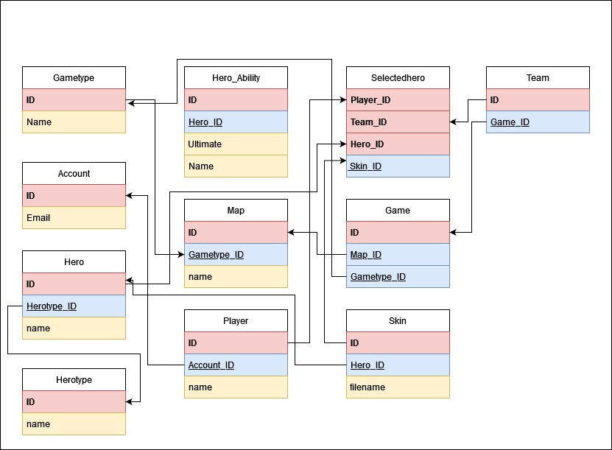
Database Schema

Slide 11
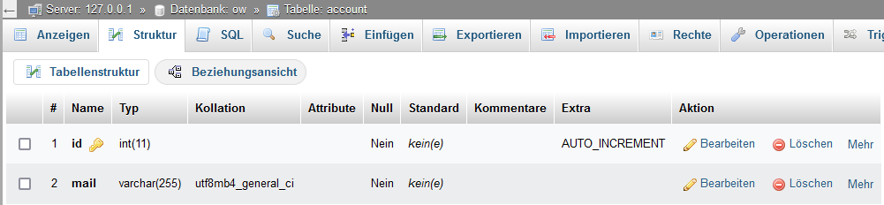
(Physical) Database Schema

Slide 12
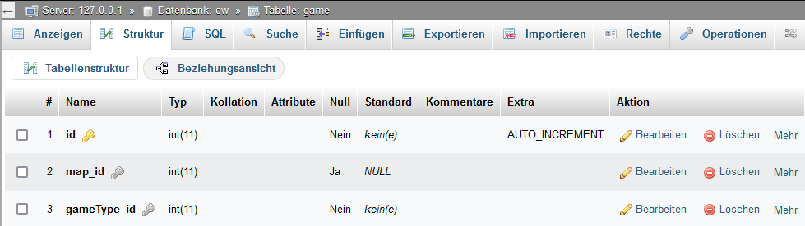
(Physical) Database Schema

Slide 13
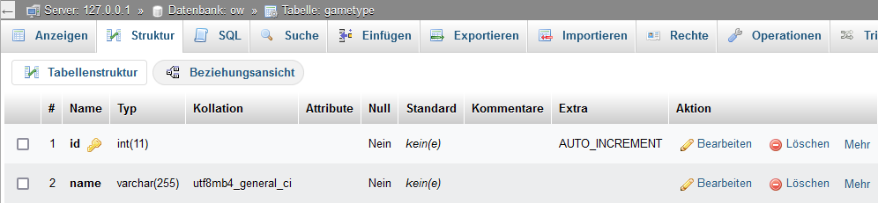
(Physical) Database Schema

Slide 14
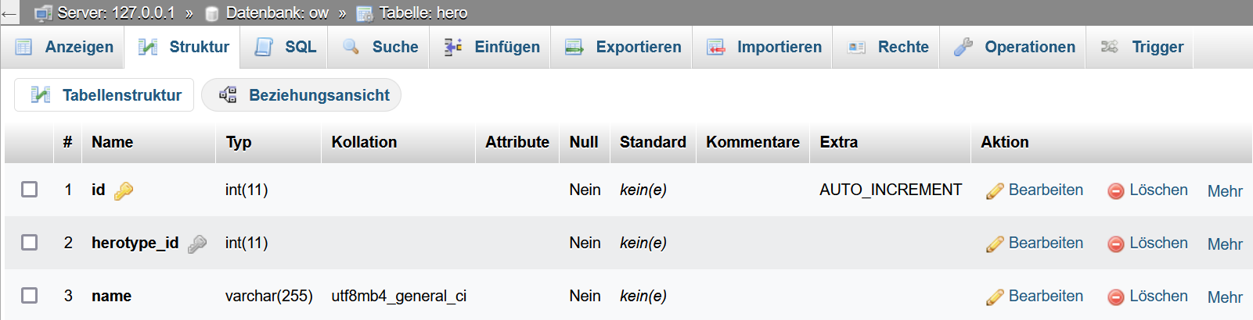
(Physical) Database Schema

Slide 15
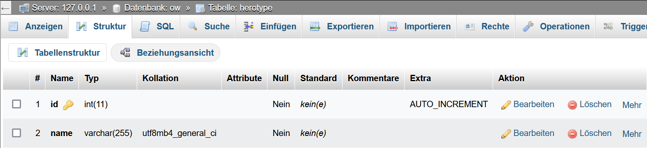
(Physical) Database Schema

Slide 16
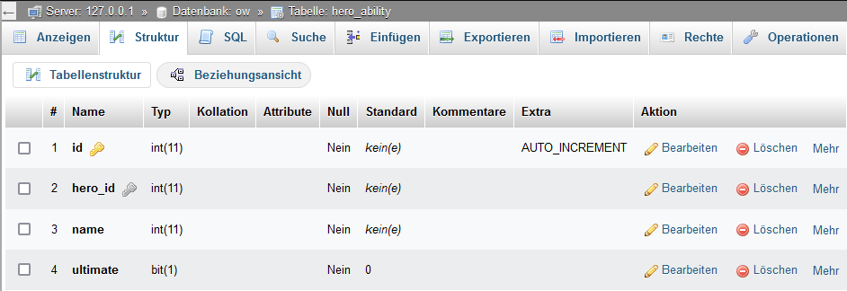
(Physical) Database Schema

Slide 17
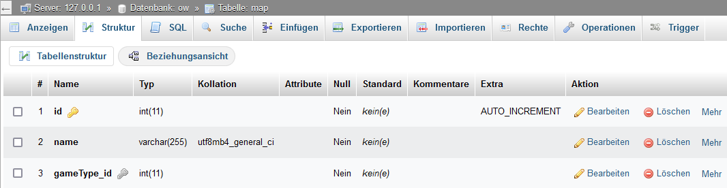
(Physical) Database Schema

Slide 18
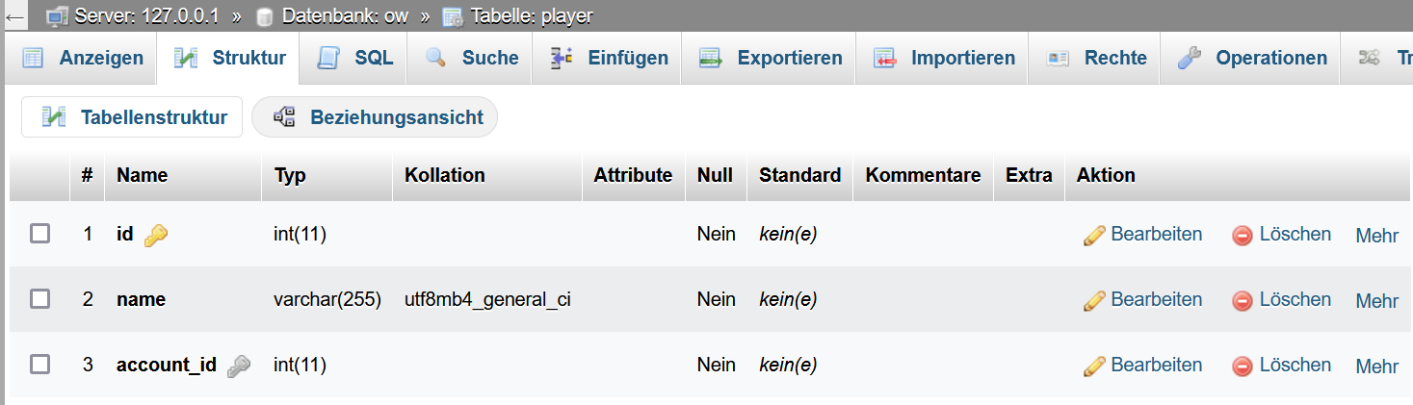
(Physical) Database Schema

Slide 19
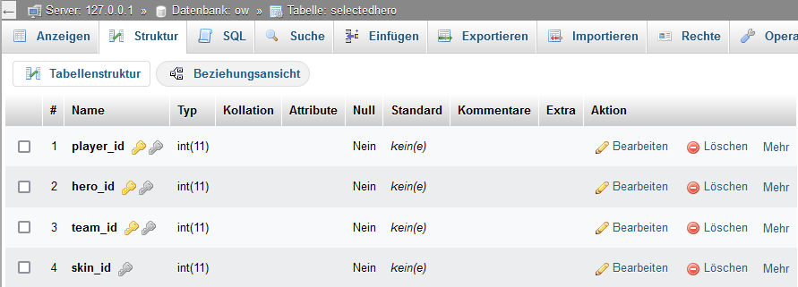
(Physical) Database Schema

Slide 20
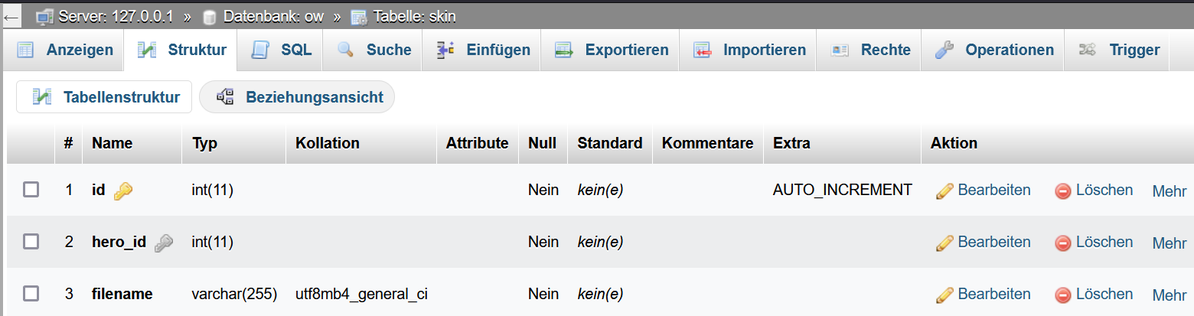
(Physical) Database Schema

Slide 21
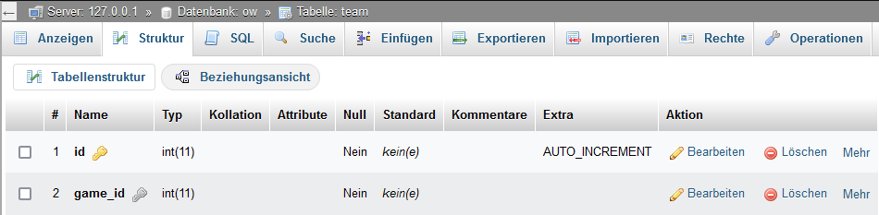
(Physical) Database Schema

Slide 22
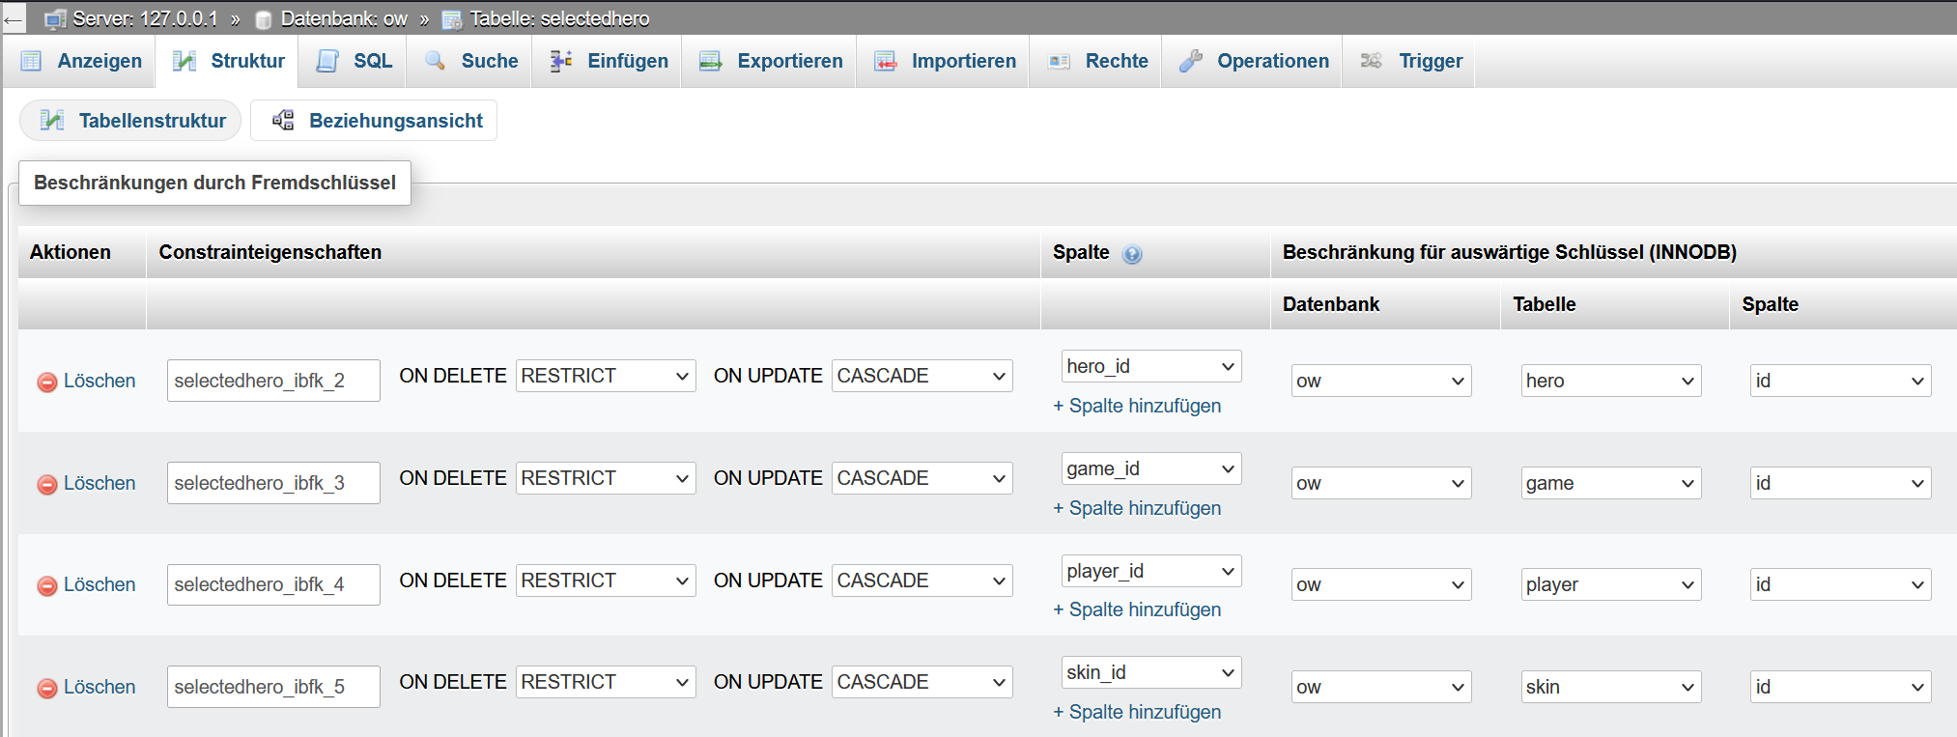
(Physical) Database Schema

Slide 23
Queries
Erika, Kevin, Timo, Roman

Slide 24
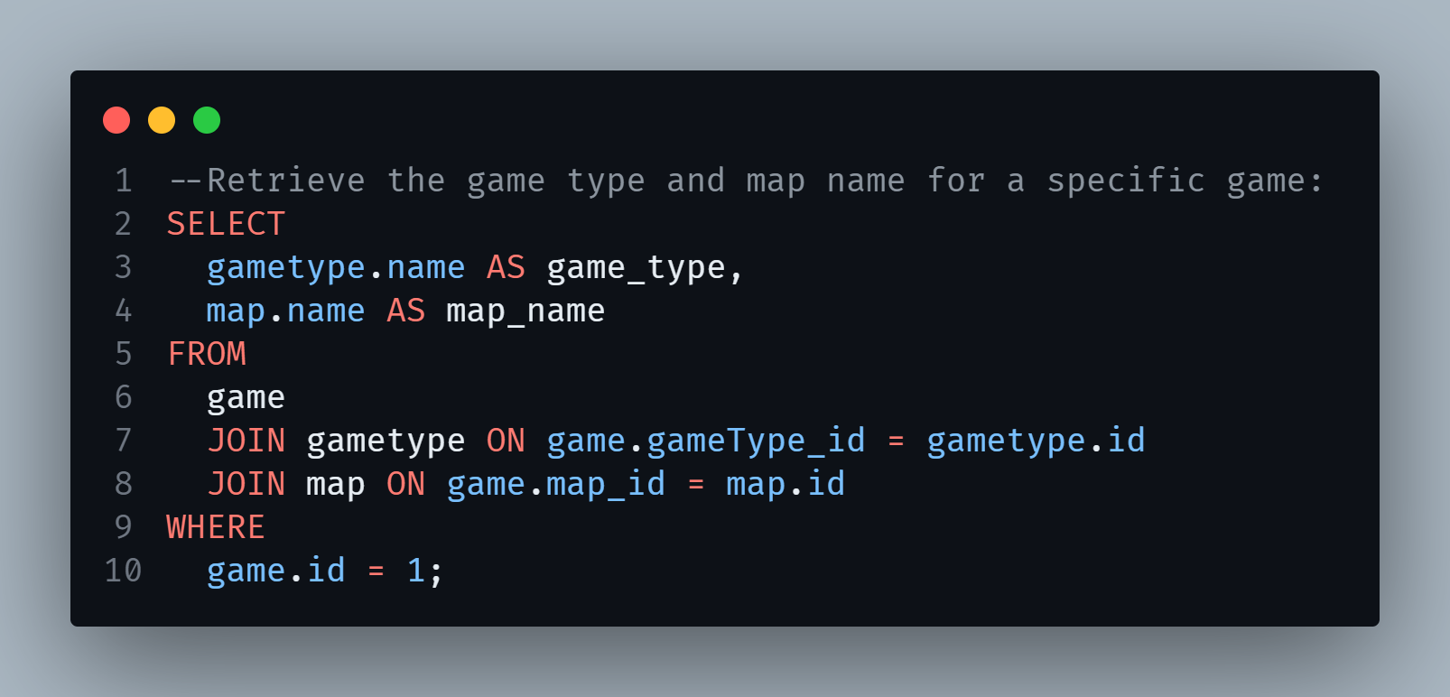
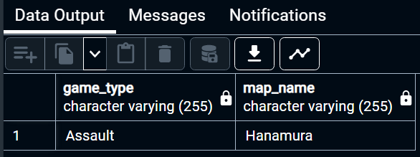
Queries

Slide 25
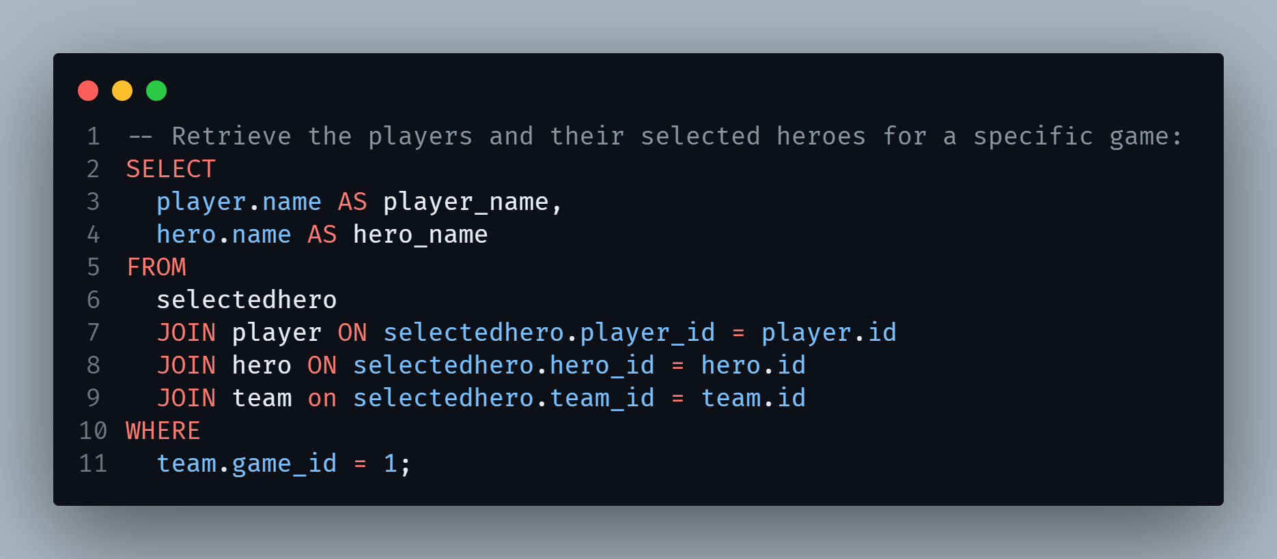
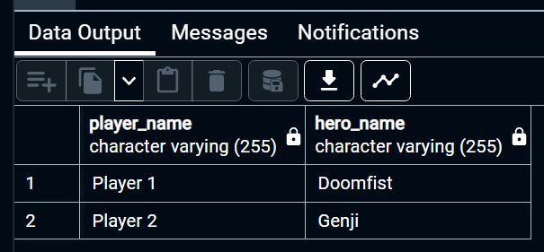
Queries

Slide 26
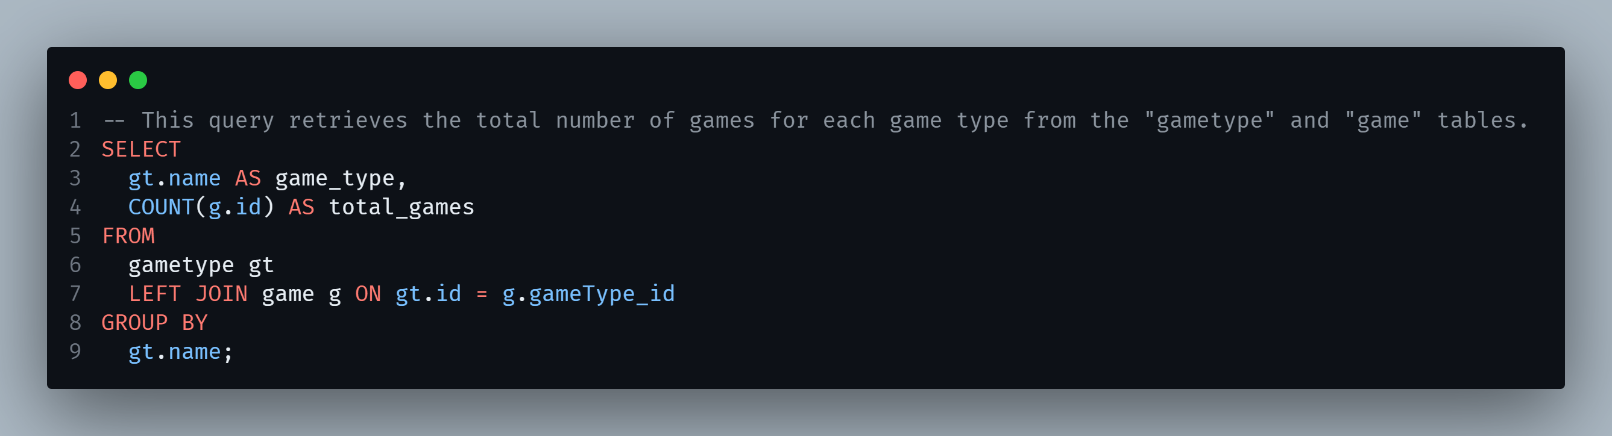
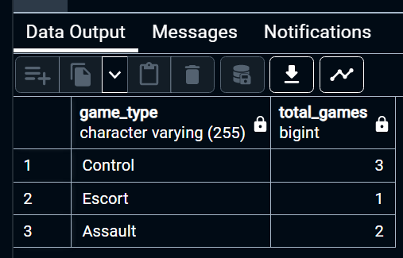
Queries

Slide 27
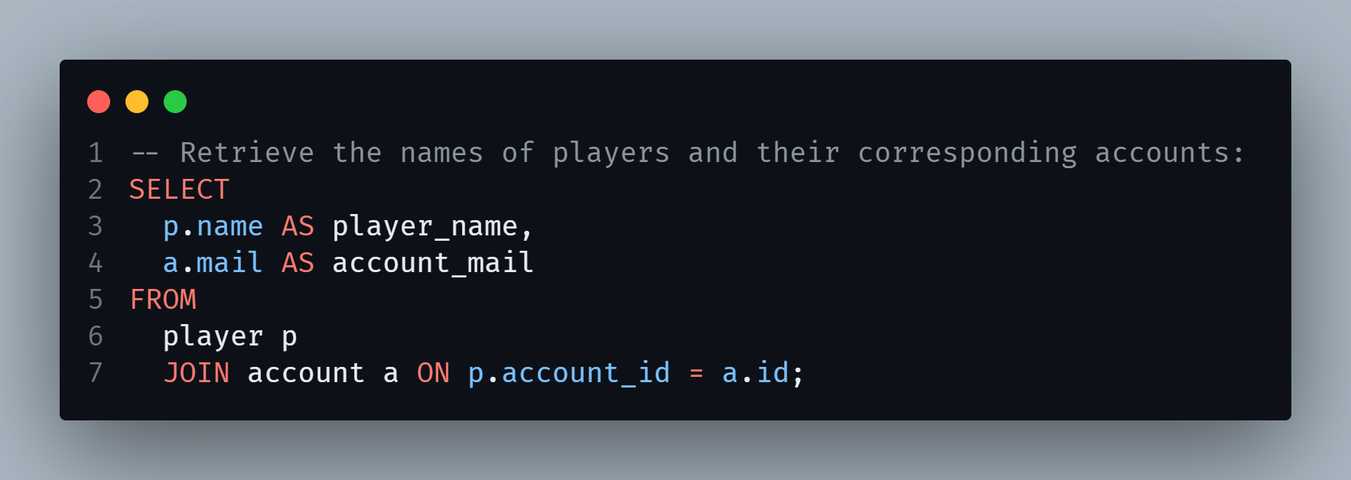
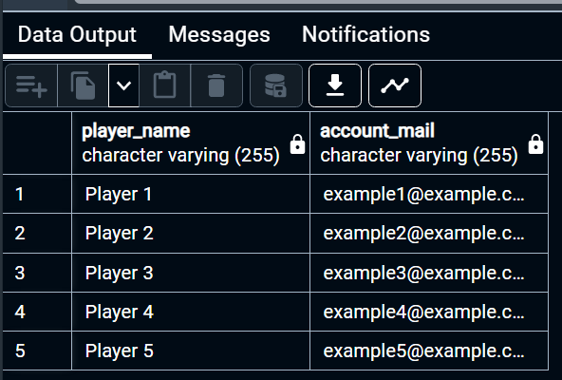
Queries
Notes:
Kevin

Slide 28
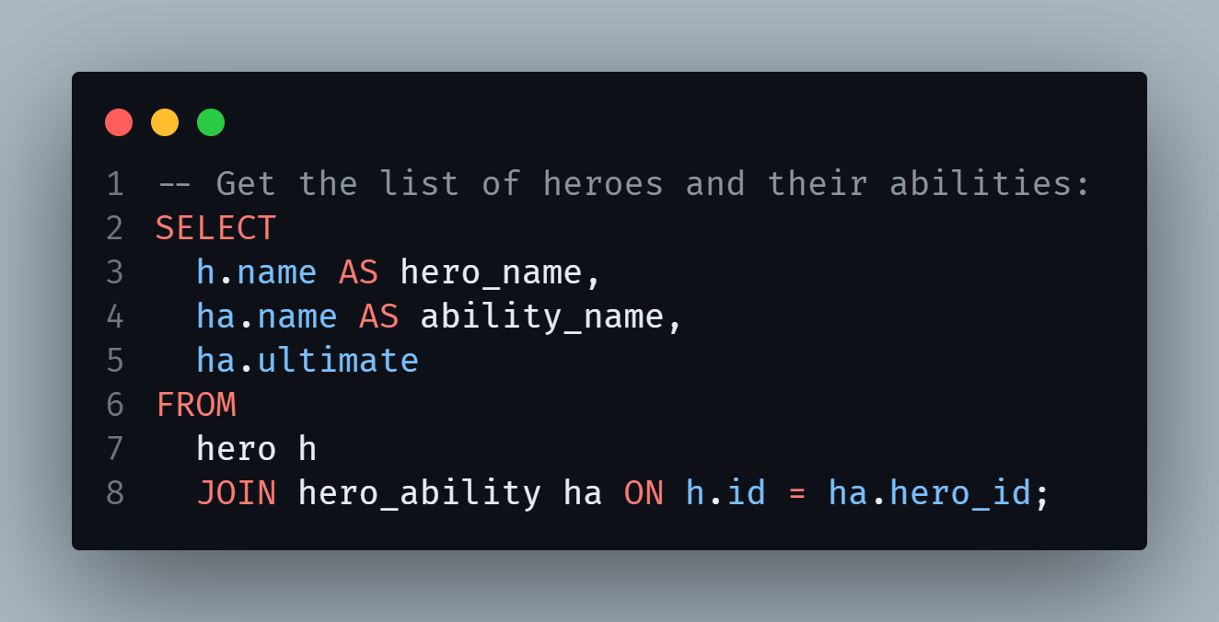
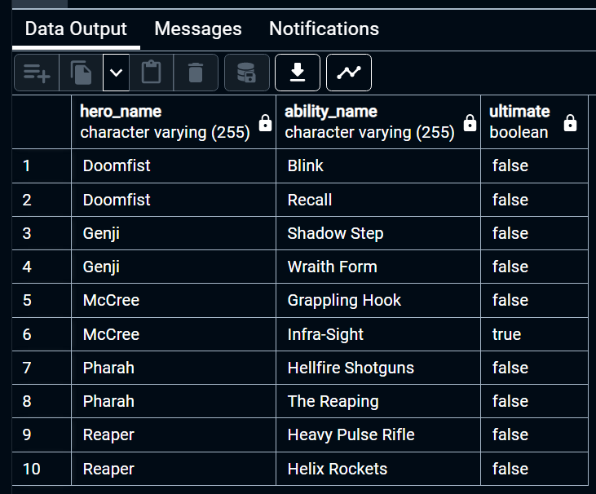
Queries
Notes:
Kevin

Slide 29
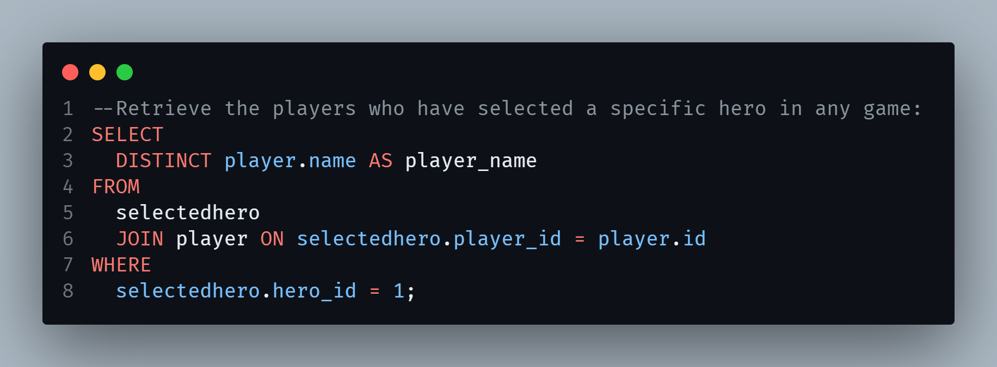
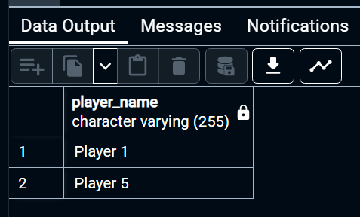
Queries
Notes:
Kevin

Slide 30
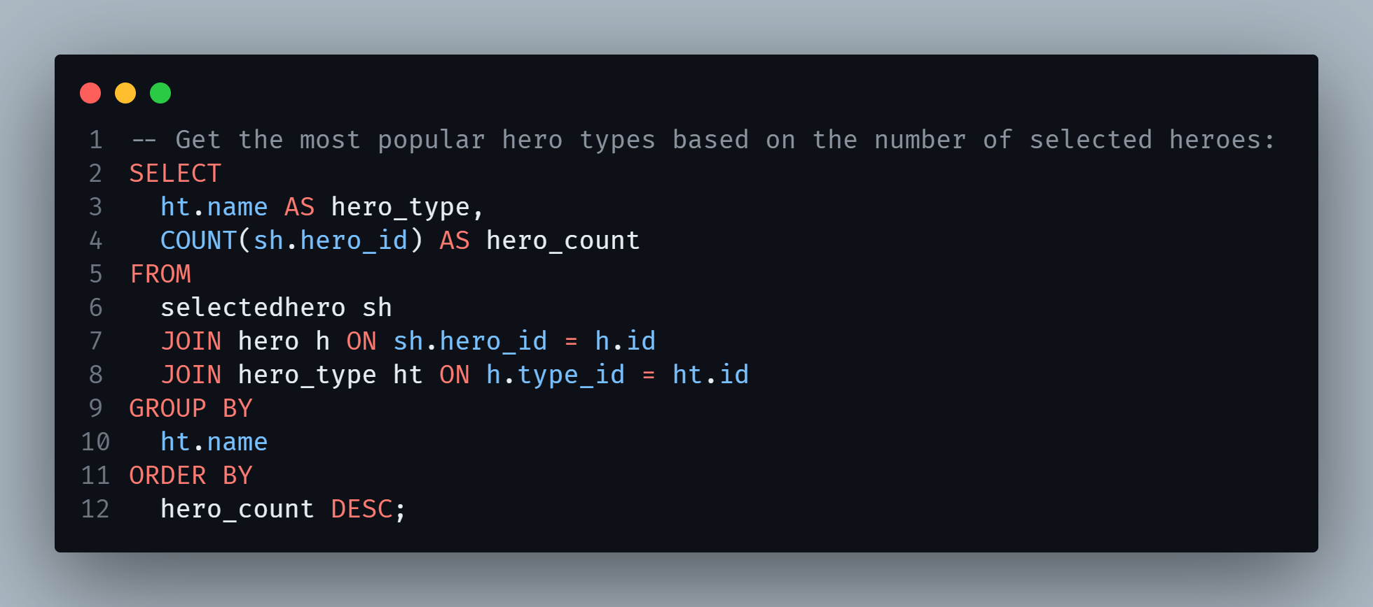
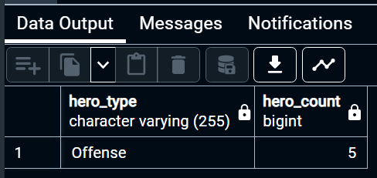
Queries
Notes:
Kevin

Slide 31
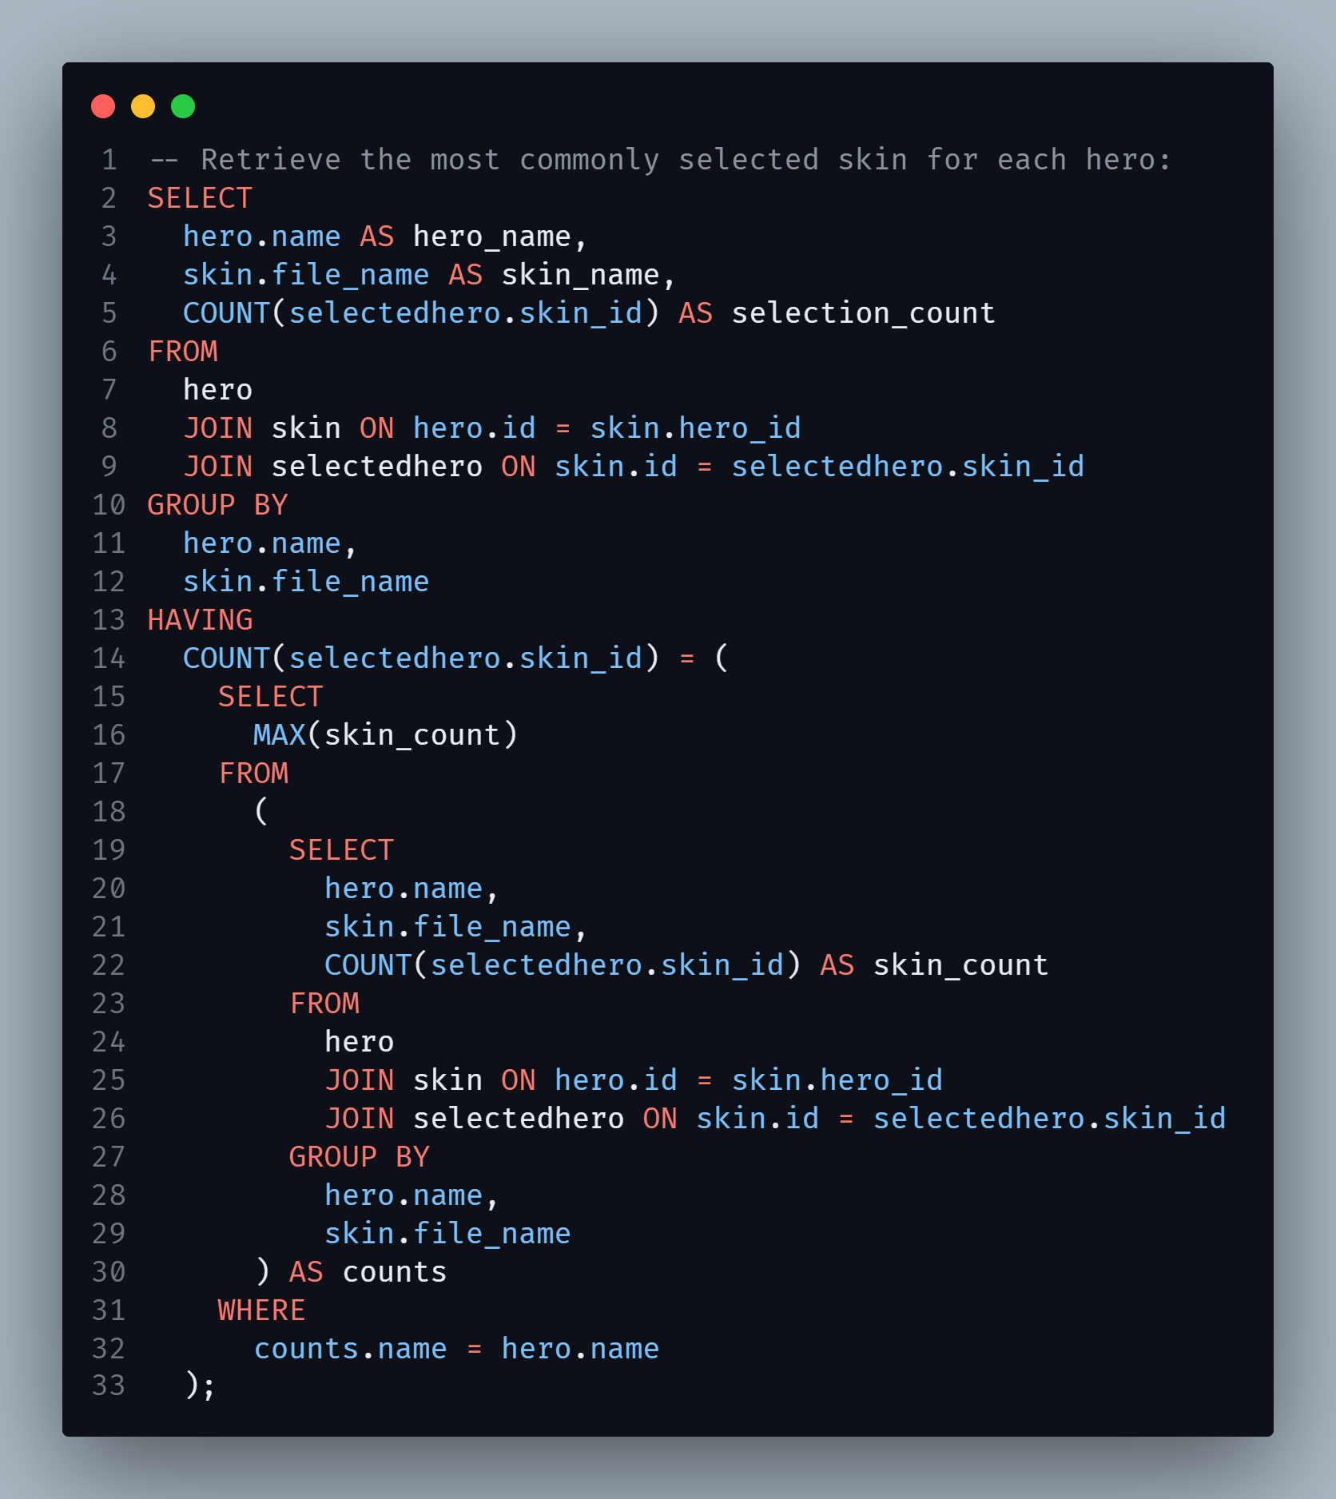
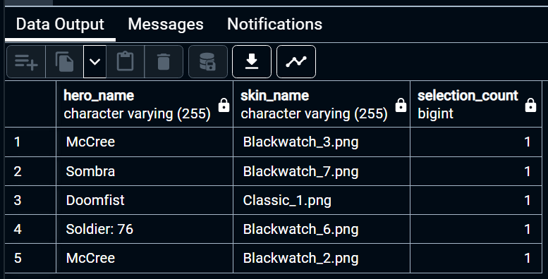
Queries
Notes:
Kevin

Slide 32
Thank you for your attention
Erika, Kevin, Timo, Roman

